Slide 1

CCPS 506
Comparative Programming Languages
Fall 2019
Lecture 6: Pure functional, Haskell intro

Slide 2

Course Administration
We’re (roughly) half way through the course.
Yay!

Slide 3
Course Administration
Midterms are marked
They were well done overall
Average was around 71%
I’ll hand them back after today’s lecture
We’ll go over them

Slide 4
Course Administration
What’s left?
Haskell (2-3 classes, 2 labs)
Rust (2-3 classes, 2 labs)
Assignments due Dec 3rd, 11:59
Final Exam on Dec 7, covers everything
More on Haskell and Rust
Will still include Smalltalk and Elixir

Slide 5

Any Questions?

Slide 6
Today
Intro to Haskell
Hand back and take up midterm
Lab #5
No lab assignment today.
Haskell labs will start next week

Slide 7
Let’s Get Started!

Slide 8
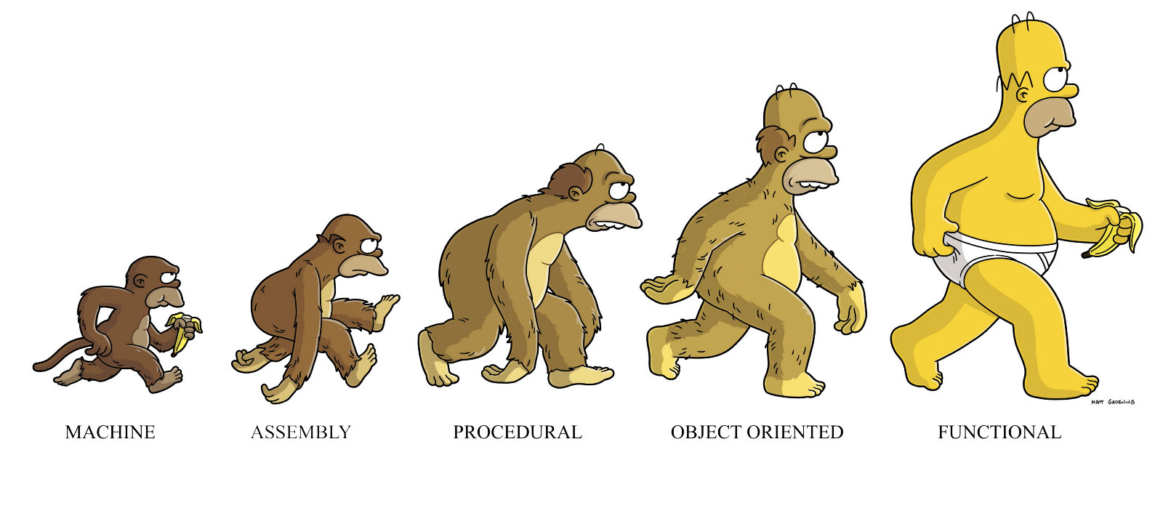

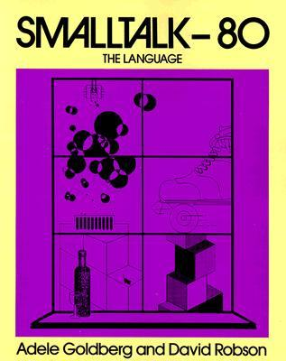
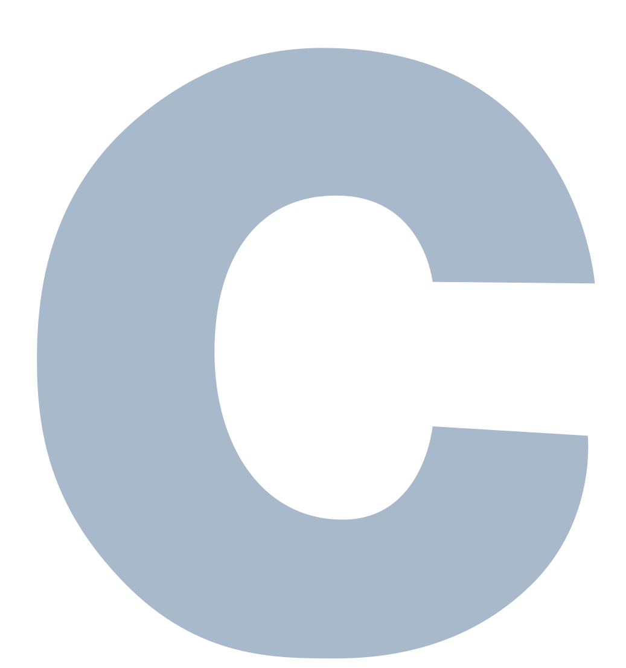
Functional Programming

Slide 9


Slide 10

Functional Programming

Slide 11
Functional Programming
Higher-order functions:
Functions that return functions or accept them as arguments
First class functions:
Can appear anywhere in the program that other first class entities (such as numeric types) can. Arguments, return values, etc.
Pure Functions:
Functions that have no side effects - one to one mapping between function input and output.
If two pure functions do not have a data dependency, their ordering is irrelevant and they can be parallelized (thread-safe)

Slide 12
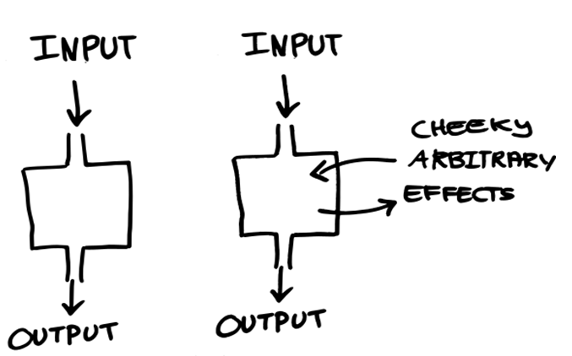
Pure function
Impure function

Slide 13
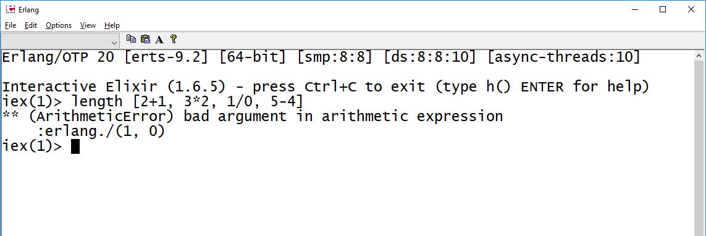
Functional Programming
Strict (eager) VS. non-strict (lazy) evaluation:
Strict: evaluate function arguments before invoking the function.
Lazy: Evaluates arguments if their value is required to invoke the function.
Elixir largely performs strict evaluation (some exceptions, recall streams, ranges)

Slide 14
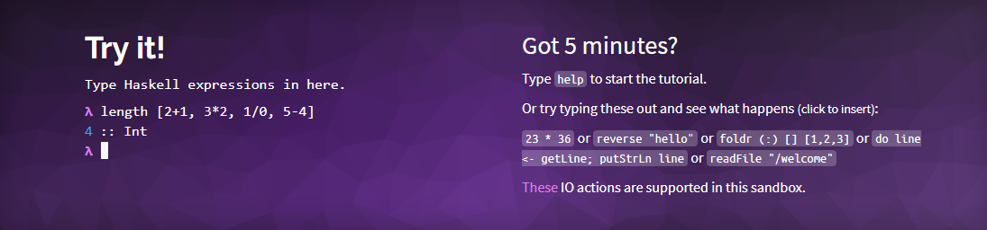
Functional Programming
Strict (eager) VS. non-strict (lazy) evaluation:
Strict: evaluate function arguments before invoking the function.
Lazy: Evaluates arguments if their value is required to invoke the function.
Everyone should do this ASAP!
A great intro to Haskell syntax

Slide 15
Functional programming language
Runs on Erlang (BEAM) VM
Erlang functions available in Elixir
:math.pow()
Mostly immutable
Rich support for concurrency
Emphasizes recursion and higher-order functions
Elixir offers many conveniences for structuring programs in a familiar way.

Slide 16
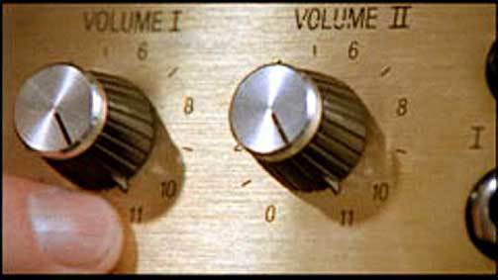
Haskell: Functional Programming cranked up to 11

Slide 17
Haskell History:
Named after logician Haskell Curry
In the late 80s, interest in lazy functional languages was growing
There was a strong consensus to define an open standard for such languages
Haskell 1.0 was defined in 1990
Continued with version 1.1, 1.2, 1.3, etc.
Culminated with Haskell 98
Haskell 2010 was published in July 2010
Contained well-used uncontroversial features previously enabled via compiler flags
Next version is being worked on – Haskell 2020

Slide 18
Features
Purely Functional:
Every function is pure
Even side-effect inducing operations are produced by pure code
No statements, only expressions
Cannot mutate variables (local or global)
Supports pattern matching
Side effects are handled using monads

Slide 19
Features
Statically Typed:
Every expression has a type
Determined at compile time
Types composing an expressions must match
If not, compile error
Type Inference:
Types don’t have to be written out explicitly
Though you can if you want
They will be inferred at compile time

Slide 20
Features
Lazy Evaluation:
Functions don’t evaluate their arguments
Control constructs written as functions
Easy to fuse chains of functions together
Computation never takes place unless a result is used.
Concurrency:
GHC (Haskell compiler) includes high performance parallel garbage collector
Light-weight concurrency library

Slide 21
Haskell in Industry?
https://wiki.haskell.org/Haskell_in_industry

Slide 22
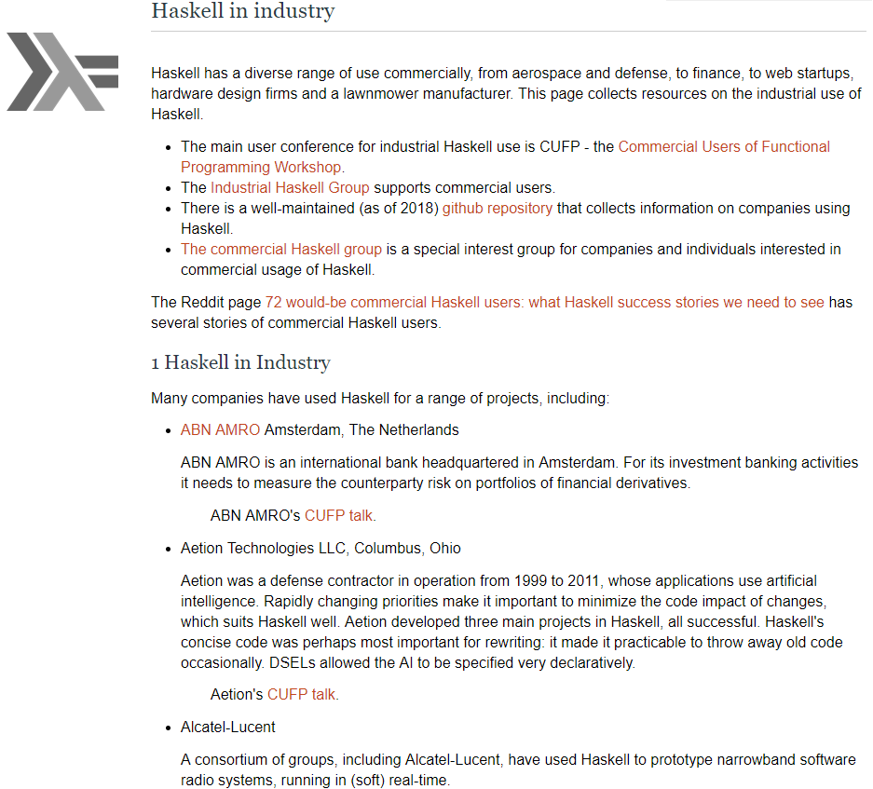
Notable companies that use or have used Haskell:
Nvidia
AT&T
Ericsson
Facebook
Google
Intel
Microsoft
Typically Haskell is used on specialized internal projects or research. Not necessarily company-wide.

Slide 23
Installing Haskell:
https://www.haskell.org/

Slide 24
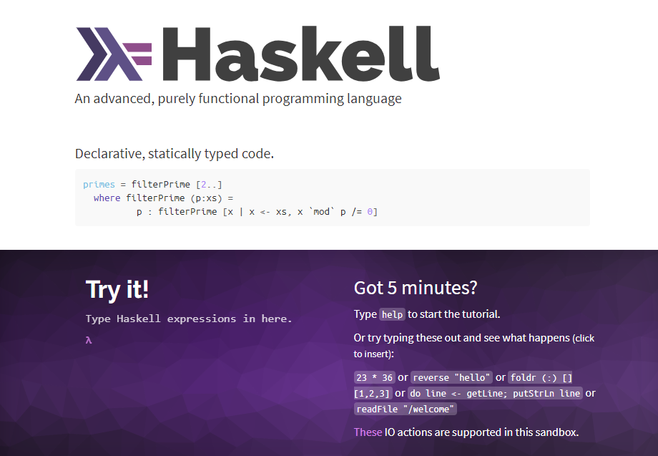
Neat!

Slide 25
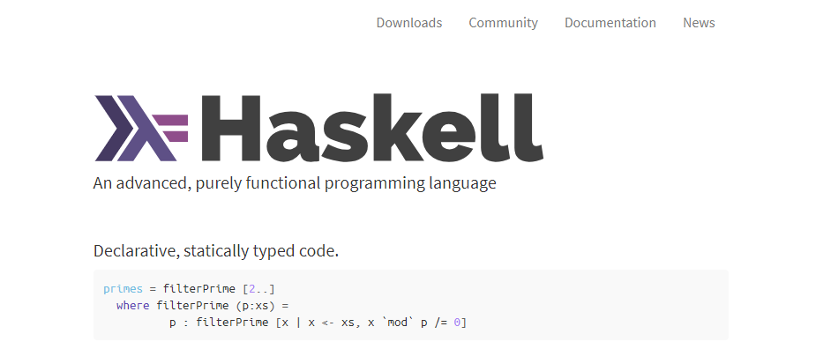
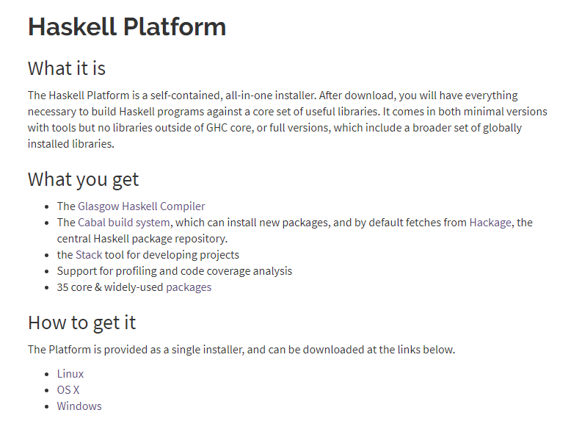

Slide 26


Slide 27
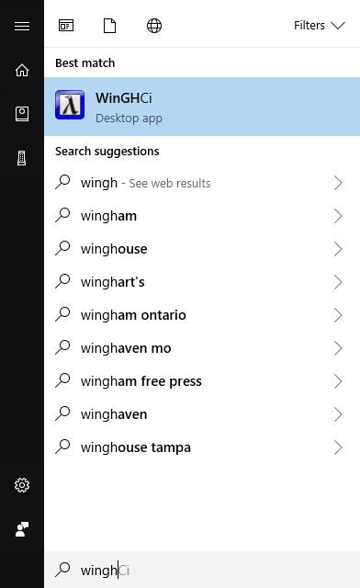
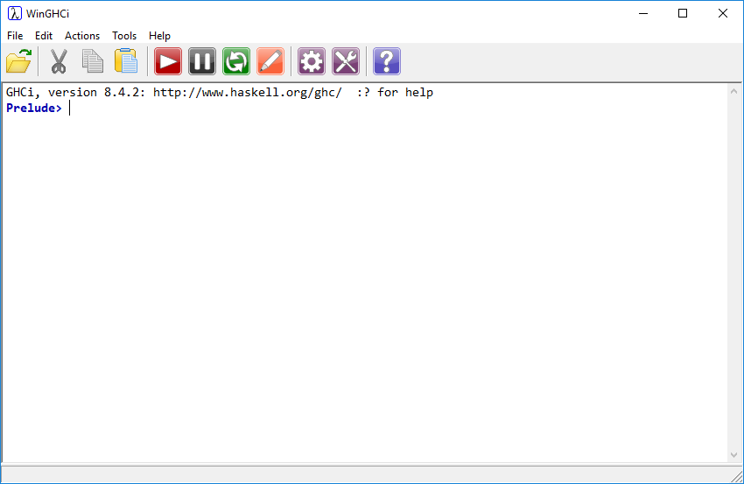
Interactive shell, just like Elixir.
Haskell’s is better!

Slide 28
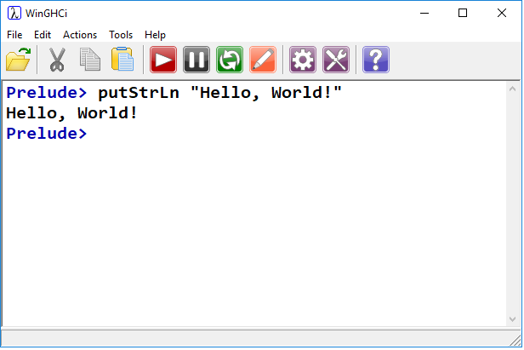

Hello, World!
putStrLn == System.out.println()
putStr == System.out.print()
Define a main function.
When compiling Haskell code, main is the entry point
Just like C or Java
Execute main function

Slide 29
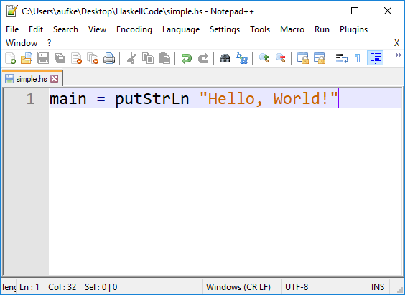
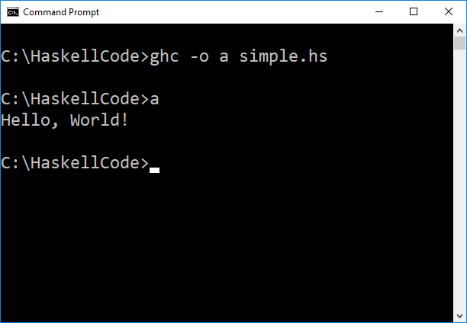
Compiling Haskell
Notepad++ features Haskell syntax highlighting!
Compilation is similar to gcc

Slide 30
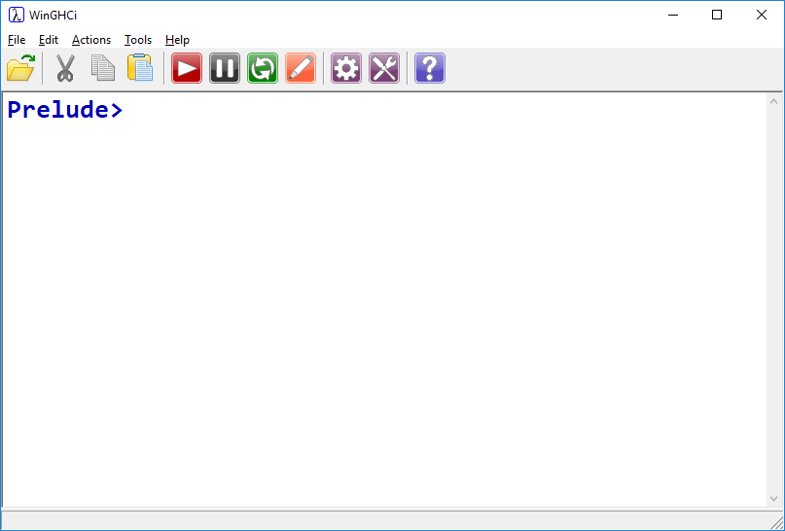
As with Elixir, we will play around in the interactive window until it becomes tedious.

Slide 31
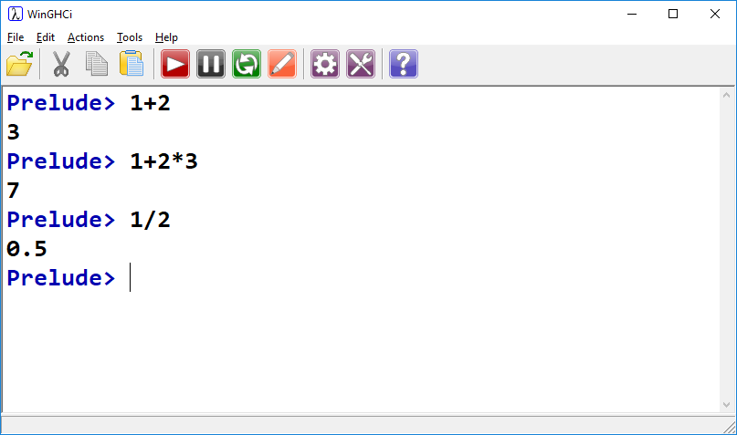
Literals & Arithmetic
Operator precedence is as expected
Division yields float

Slide 32
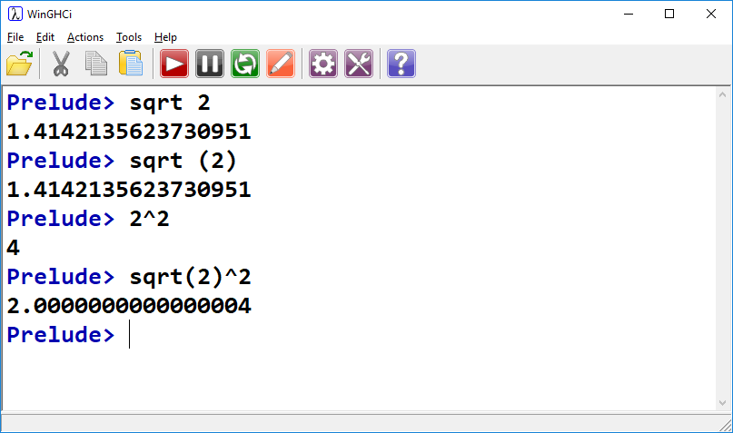
Literals & Arithmetic
Like Elixir, can omit brackets on function calls
^ can be used for exponentiation
Rounding error, no escaping it.

Slide 33
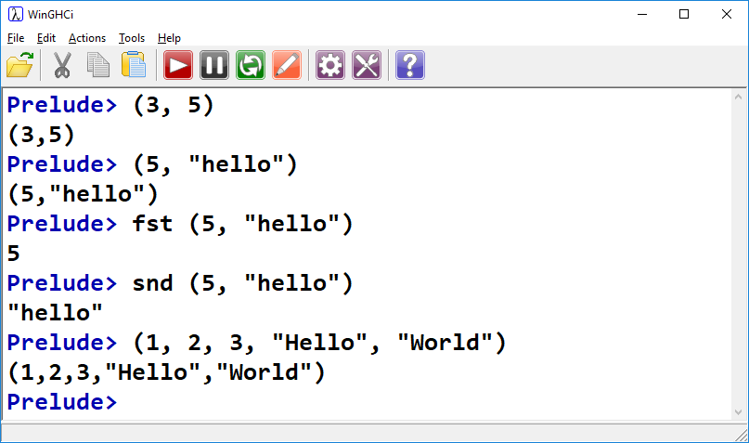
Tuples
Like Elixir, Haskell supports tuples.
They need not contain the same types.
There are built in functions for accessing first and second elements. Great for coordinates.

Slide 34
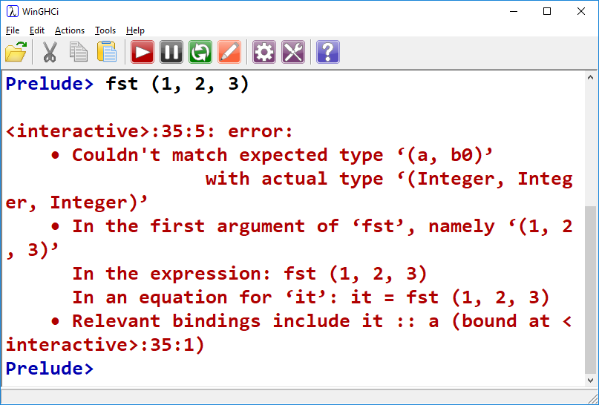
fst and snd only work on pair tuples!

Slide 35
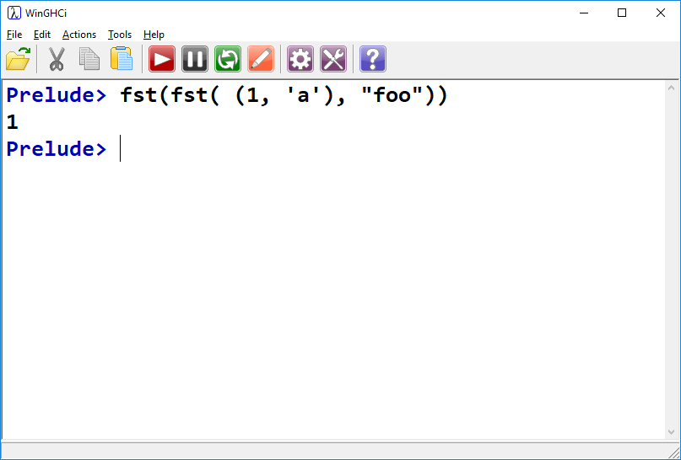
We can nest fst calls

Slide 36
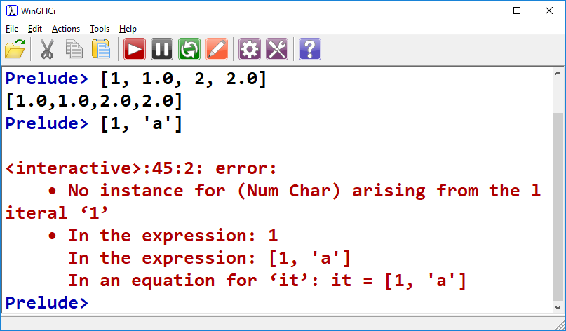
Lists
Must be homogeneous:
Integers get converted to floating point
Characters do not

Slide 37
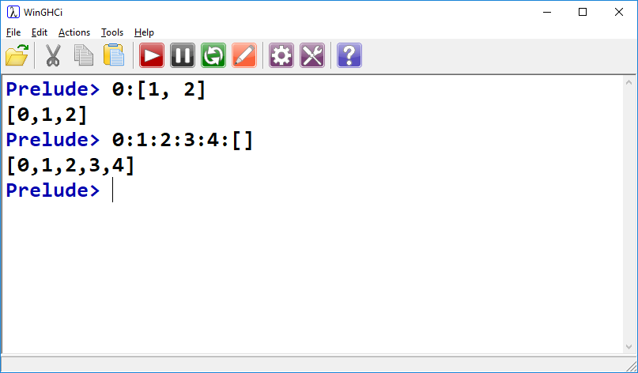
Lists
Elements can be added to the beginning of a list with the cons ( : ) operator
Build a list using cons operator and an empty list
In fact, when we write [1, 2, 3] the compiler is actually doing 1:2:3:[]
[1, 2, 3] notation is syntactic sugar.

Slide 38
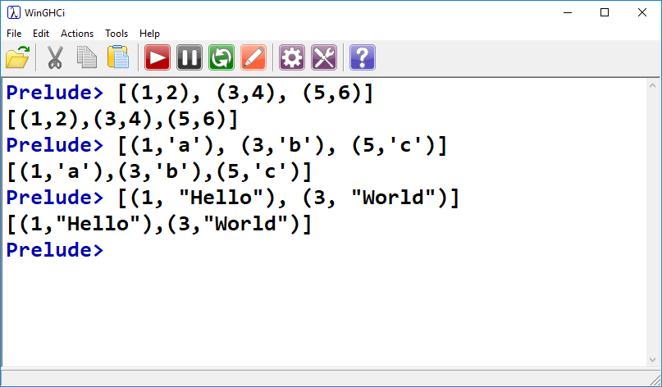
Lists & Tuples
Tuples can be heterogeneous, lists must be homogeneous.
However! We can have lists of tuples, where each tuple is heterogeneous.

Slide 39
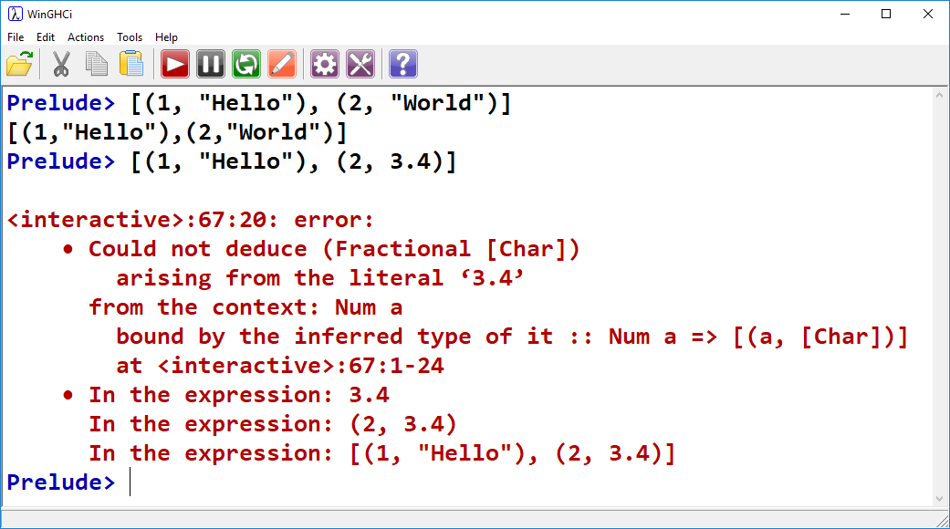
Lists & Tuples
Tuples can be heterogeneous, lists must be homogeneous.
However #2!
In a list of tuples, each tuple must have the same format:

Slide 40
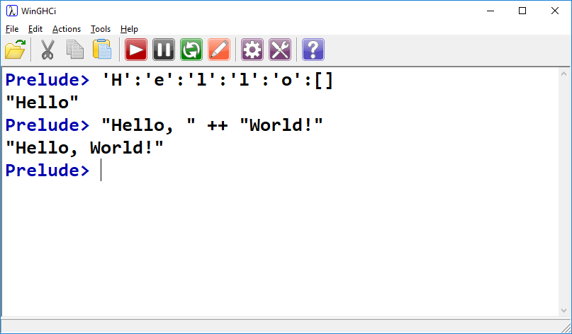
Strings
Strings are simply lists of chars:
We can cons chars into an empty list to form a string
We can concatenate strings using the ++ operator

Slide 41
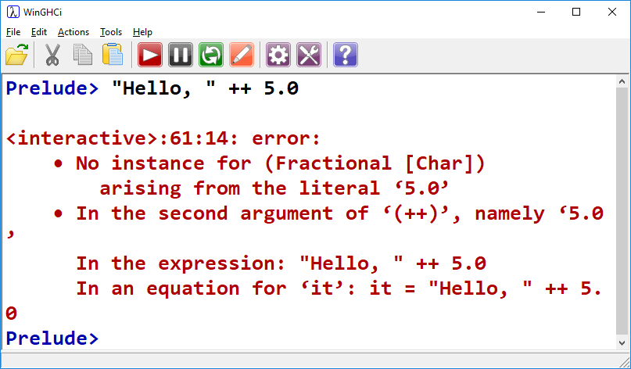
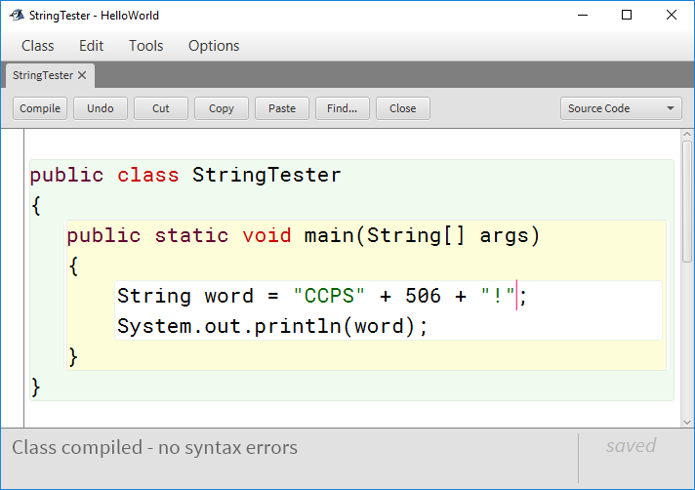
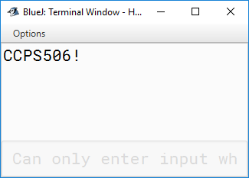
Strings
Concatenate multiple types? Java lets us…

Slide 42
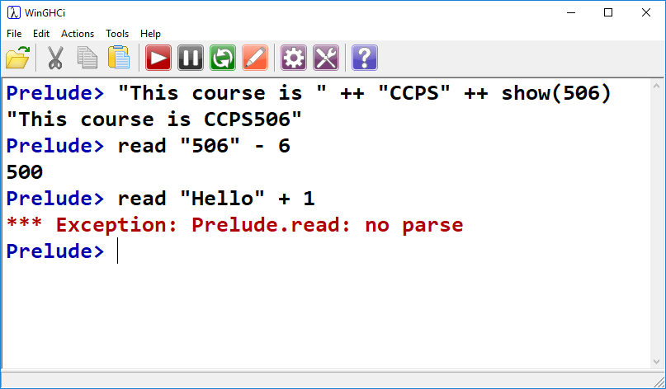
Strings
show() and read() functions
Convert non-string argument to string
Read numeric value from a string (like sscanf in C)
Error when no numeric value is present

Slide 43
Operations on Lists
In functional programming, computation is done in large part by operating on lists.
We saw the hd, tl, |, and Enum functions in Elixir.
Haskell has a similar set of operations.
Three primary list-processing functions: map, filter, foldr (and foldl)

Slide 44
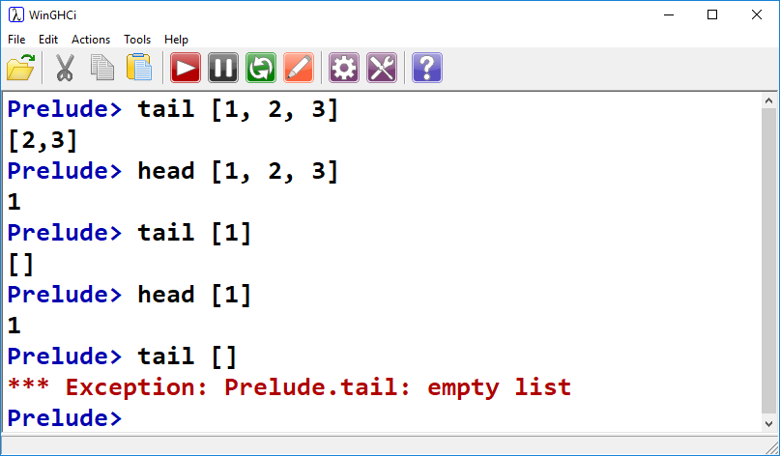
Head & Tail
Same as Elixir:
Head returns the first element
Tail returns the rest, as a list
Note boundary cases:
Single element lists
Empty lists

Slide 45
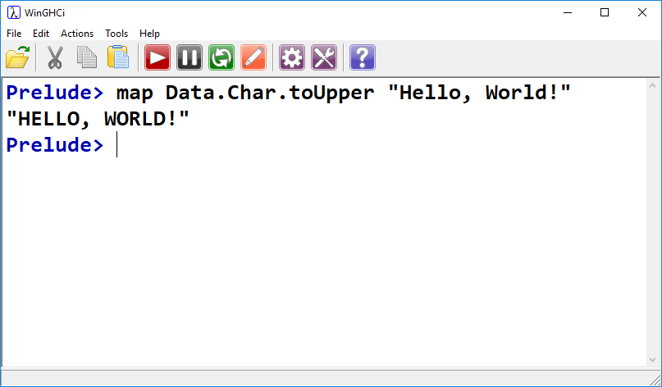
map
Similar to Elixir’s Enum.map
First class function, does what name suggests.
Alphabetical characters are upped, everything else is left the same.
Recall: map operates on lists, but a string is just a list of characters

Slide 46
map
Similar to Elixir’s Enum.map
Map takes two arguments: A function, and a list of values to which the function is to be applied.

Slide 47
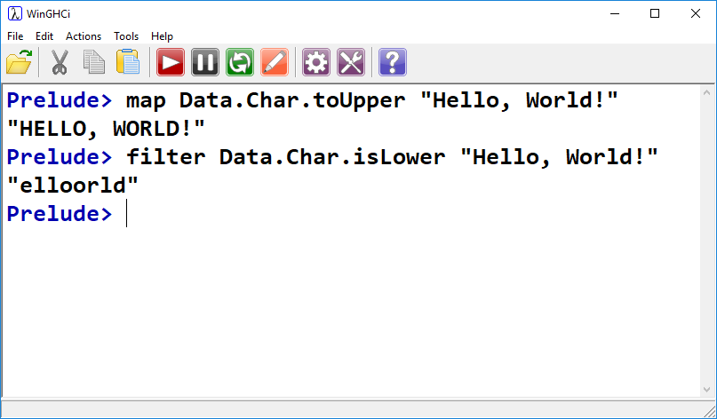
filter
“Remove” items from a list based on some criteria:
Function
List

Slide 48
foldl, foldr
Replaces the cons operator with some other function. This takes some explaining.
Recall that the list:
[1, 2, 3, 4, 5]
Is actually seen as:
1:2:3:4:5:[]
By the compiler.

Slide 49
foldl, foldr
Replaces the cons operator with some other function. This takes some explaining.
Recall that the list:
[1, 2, 3, 4, 5]
Is actually seen as:
1:2:3:4:5:[]
By the compiler.
foldr in effect replaces the cons operator with another function of our choosing.
This is similar to Enum.reduce in Elixir.
The empty list is replaced with some initial value.

Slide 50
foldl, foldr
Replaces the cons operator with some other function. This takes some explaining.
foldr in effect replaces the cons operator with another function of our choosing.
This is similar to Enum.reduce in Elixir.
The empty list is replaced with some initial value.
foldr (+) 0 [1, 2, 3, 4, 5]
Three arguments: function, initial value, list

Slide 51
foldl, foldr
Replaces the cons operator with some other function. This takes some explaining.
foldr (+) 0 [1, 2, 3, 4, 5]
foldr (+) 0 1:2:3:4:5:[]
1 + 2 + 3 + 4 + 5 + 0
15

Slide 52
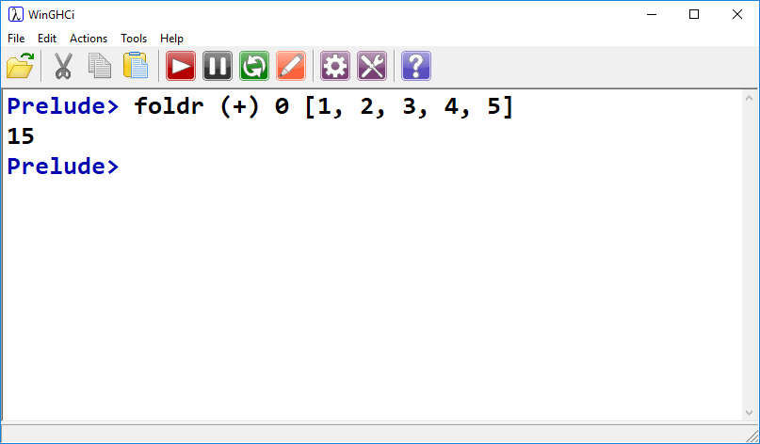

foldl, foldr
foldr to perform factorial!

Slide 53
foldl VS foldr
foldr is right associative. Meaning:
foldr (+) 0 [1, 2, 3, 4, 5]
1 + 2 + 3 + 4 + 5 + 0
Is actually:
(1 + (2 + (3 + (4 + (5 + 0)))))
Doesn’t matter for addition, but subtraction…

Slide 54
foldl VS foldr
foldr is right associative. Meaning:
foldr (-) 1 [4, 8, 5]
4 – 8 - 5 - 1
Is actually:
(4 - (8 - (5 - 1 )))
0

Slide 55
foldl VS foldr
foldl is left associative. Meaning:
foldl (-) 1 [4, 8, 5]
1 - 4 – 8 - 5
Is actually:
(((1 - 4) – 8) - 5)
-16

Slide 56
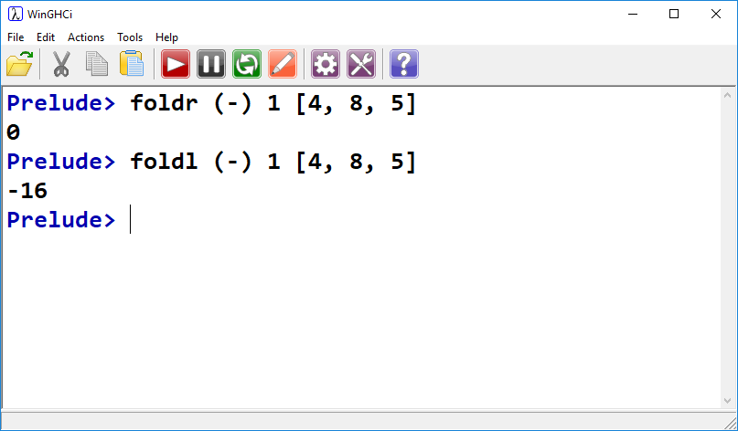
foldl VS foldr

Slide 57
List Generation
Syntactic sugar:
List declaration:
list = [1, 2, 3, 4, 5, 6, 7, 8, 9]
Can be written:
list = [1..9]
Specify interval:
list = [1,3..9]
= [1,3,5,7,9]
Interval is discerned from difference between first two elements

Slide 58
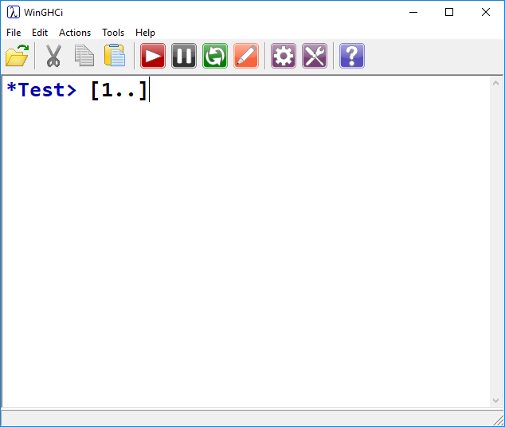
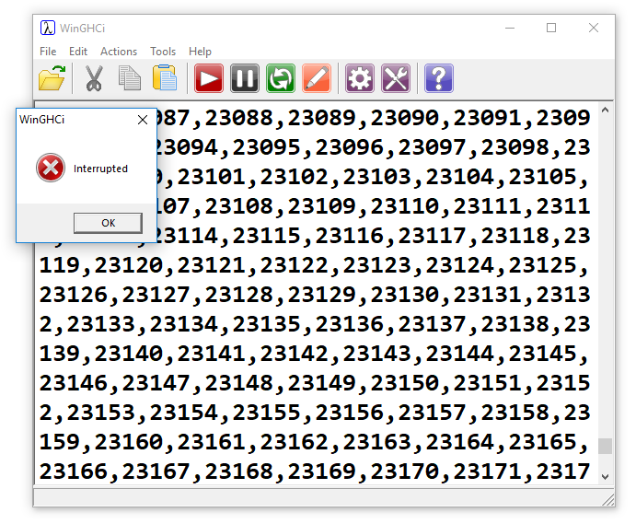
Infinite Lists?
Try it, but be ready to interrupt

Slide 59
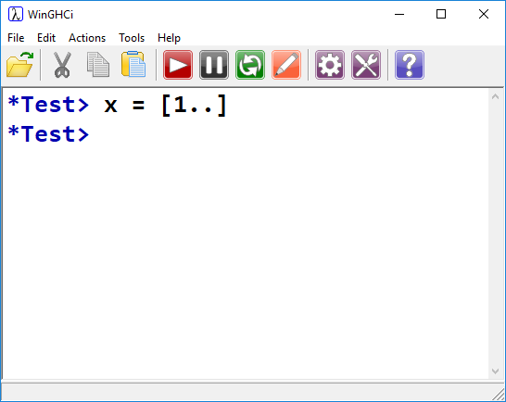
Infinite Lists?
Haskell is lazy!
We have bound x to the expression to generate an infinite list.
We don’t actually have to evaluate this list to do so!
Displaying the list, however, requires evaluation.
Why? How?

Slide 60
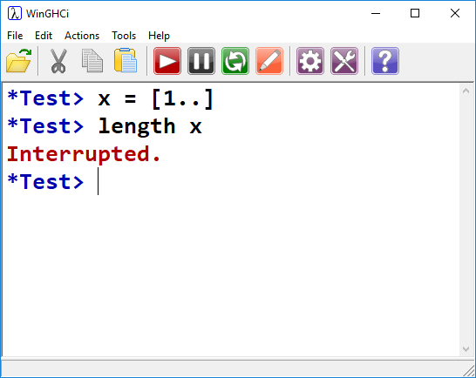
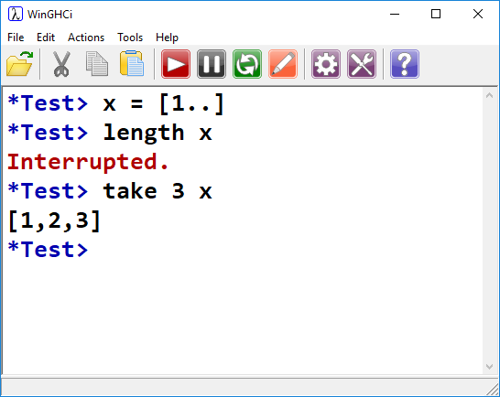
Infinite Lists?
Finding the length of the list requires counting the elements.
Be ready to interrupt.
Grab first three elements of list
Doesn’t matter if infinite, we’re only evaluating first three items

Slide 61
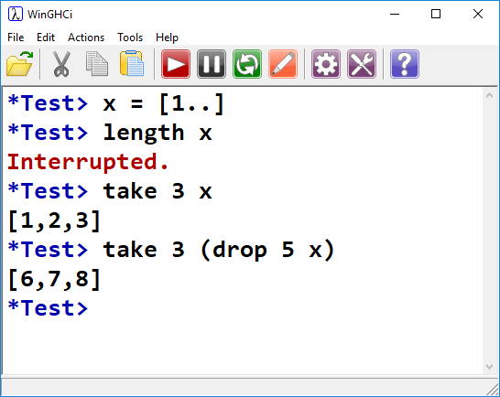
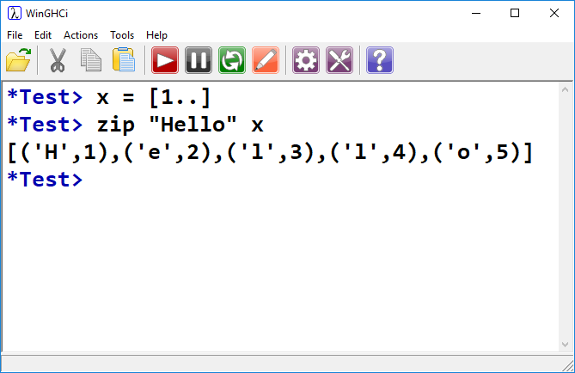
Infinite Lists?
We’re allowed to perform operations on a finite subset of an infinite list.
zip “zips” two lists together into tuples.
If one list is finite, the other can be infinite.

Slide 62
Types in Haskell
Statically Typed:
Haskell uses static type checking.
Every expression is assigned a type.
If a function’s args aren’t the expected type, a compile error occurs.
Type Inference
Unlike C or Java, and like Python, we need not specify type.
It is inferred by the context: X = “Hello” vs. String X = “Hello”
However, we are allowed to explicitly specify types.
This is sometimes good practice, improves code clarity

Slide 63
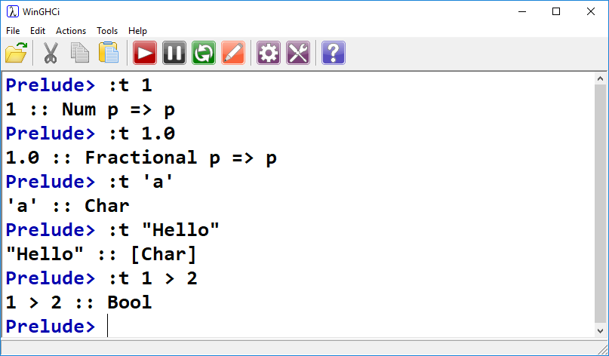
Types in Haskell
:t can be used to reveal type:
1 is instance of Num type class.
1.0 is instance of Fractional type class.
‘a’ is a Char
“Hello” is a [Char], or Char list
t is a Bool

Slide 64
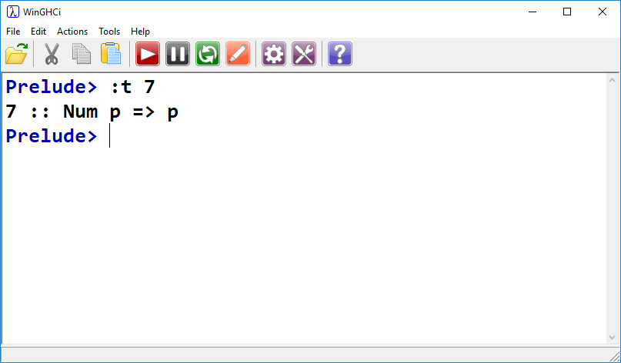
Num p => p ?
Roughly speaking:
p is a type variable whose value can be any type in typeclass Num (Int, Float, etc.)
Haskell is free to treat 7 as it sees fit, so long as it does so in a way that adheres to the operations defined in type class Num.

Slide 65
Typeclasses: A Quick Note
Haskell tries to keep types as generic as possible
If we explicitly declare a variable as integer, it can’t be passed to a function requiring float.
However, if we generically infer it to be a Num, it can be used anywhere any other member of Num is allowed.

Slide 66
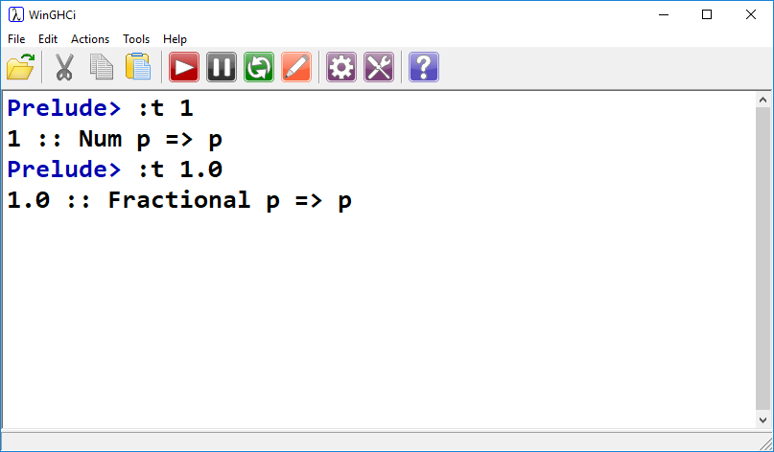
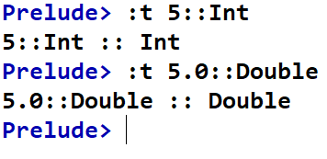
Types in Haskell
We can explicitly indicate types:
Use :: to assign a type
Again, this can be good practice
Adds clarity to code, maybe.
My advice for you is to start by letting the inference engine figure it out.
At this point, it knows better than you.

Slide 67
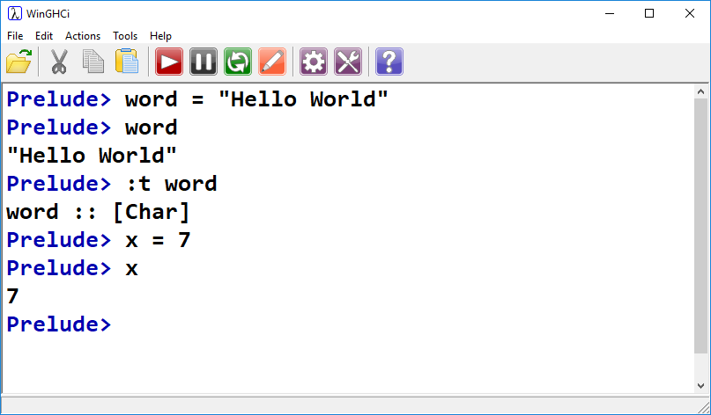
Name Definition
Allows us to re-use things later on
Name the expression “Hello World” -> word
Name the expression 7 -> x

Slide 68
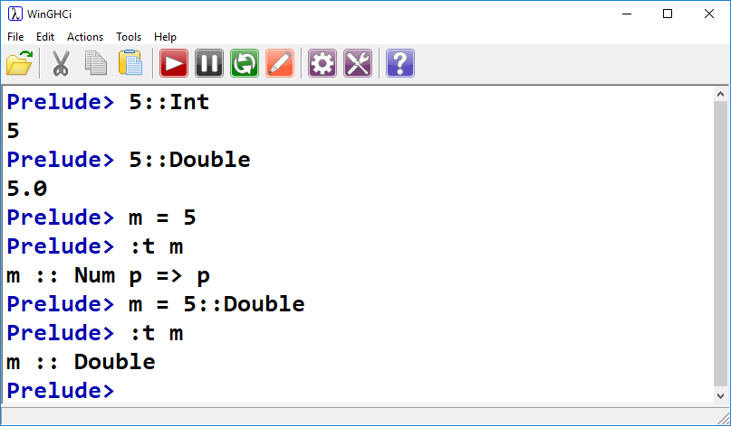
Types in Haskell
We can explicitly indicate types:
When defining a name, can indicate type explicitly:

Slide 69
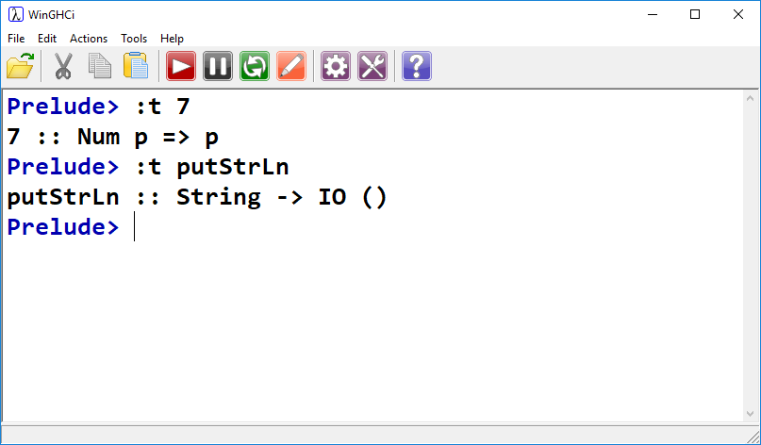
Function Types
putStrLn:
Accepts String, returns IO action.
-> indicates function
String is input, IO() is output.
More on IO actions later.

Slide 70
Haskell Tutorials/References:
https://en.wikibooks.org/wiki/Yet_Another_Haskell_Tutorial
http://cheatsheet.codeslower.com/CheatSheet.pdf

